Slide 1


DATA COMMUNICATION
CSE 225/233
WEEK-2, LESSON-2
NETWORK MODEL

Slide 2
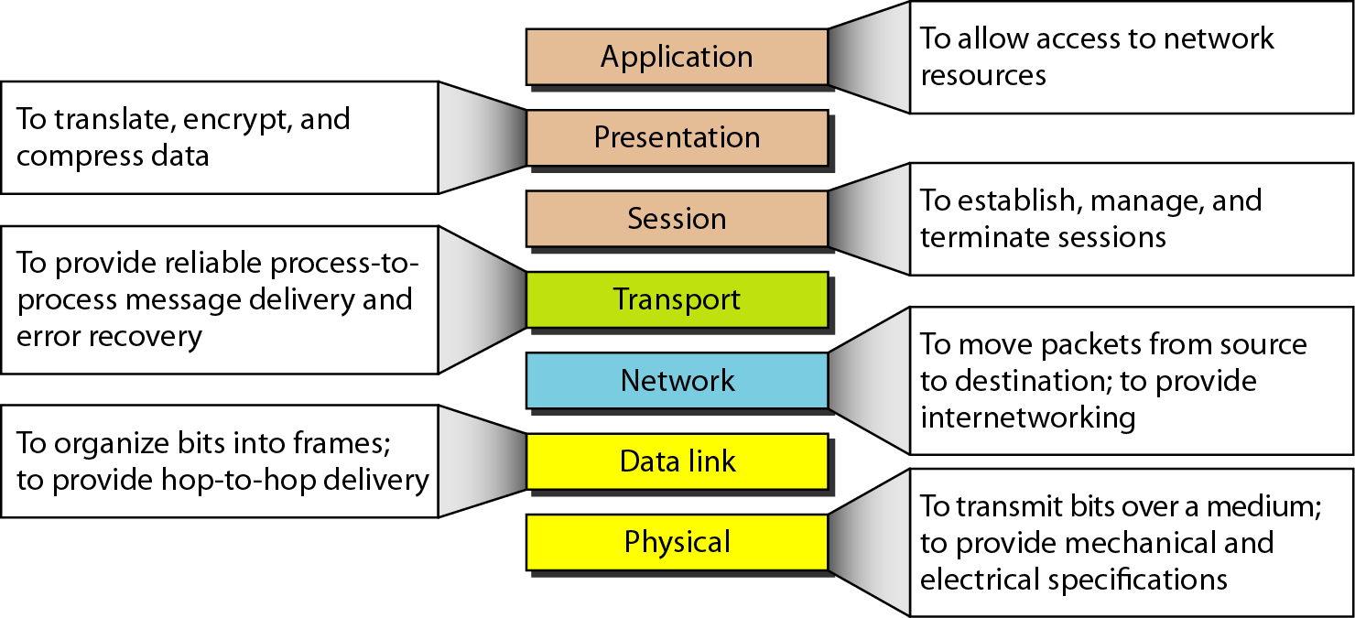
Summary of the layers
2.2

Slide 3

























































TCP/IP Protocol Suite
The layers in the TCP/IP protocol suite do not exactly match those in the OSI model. The original TCP/IP protocol suite was defined as having four layers: host-to-network, internet, transport, and application. However, when TCP/IP is compared to OSI, we can say that the TCP/IP protocol suite is made of five layers: physical, data link, network, transport, and application.
2.3

Slide 4
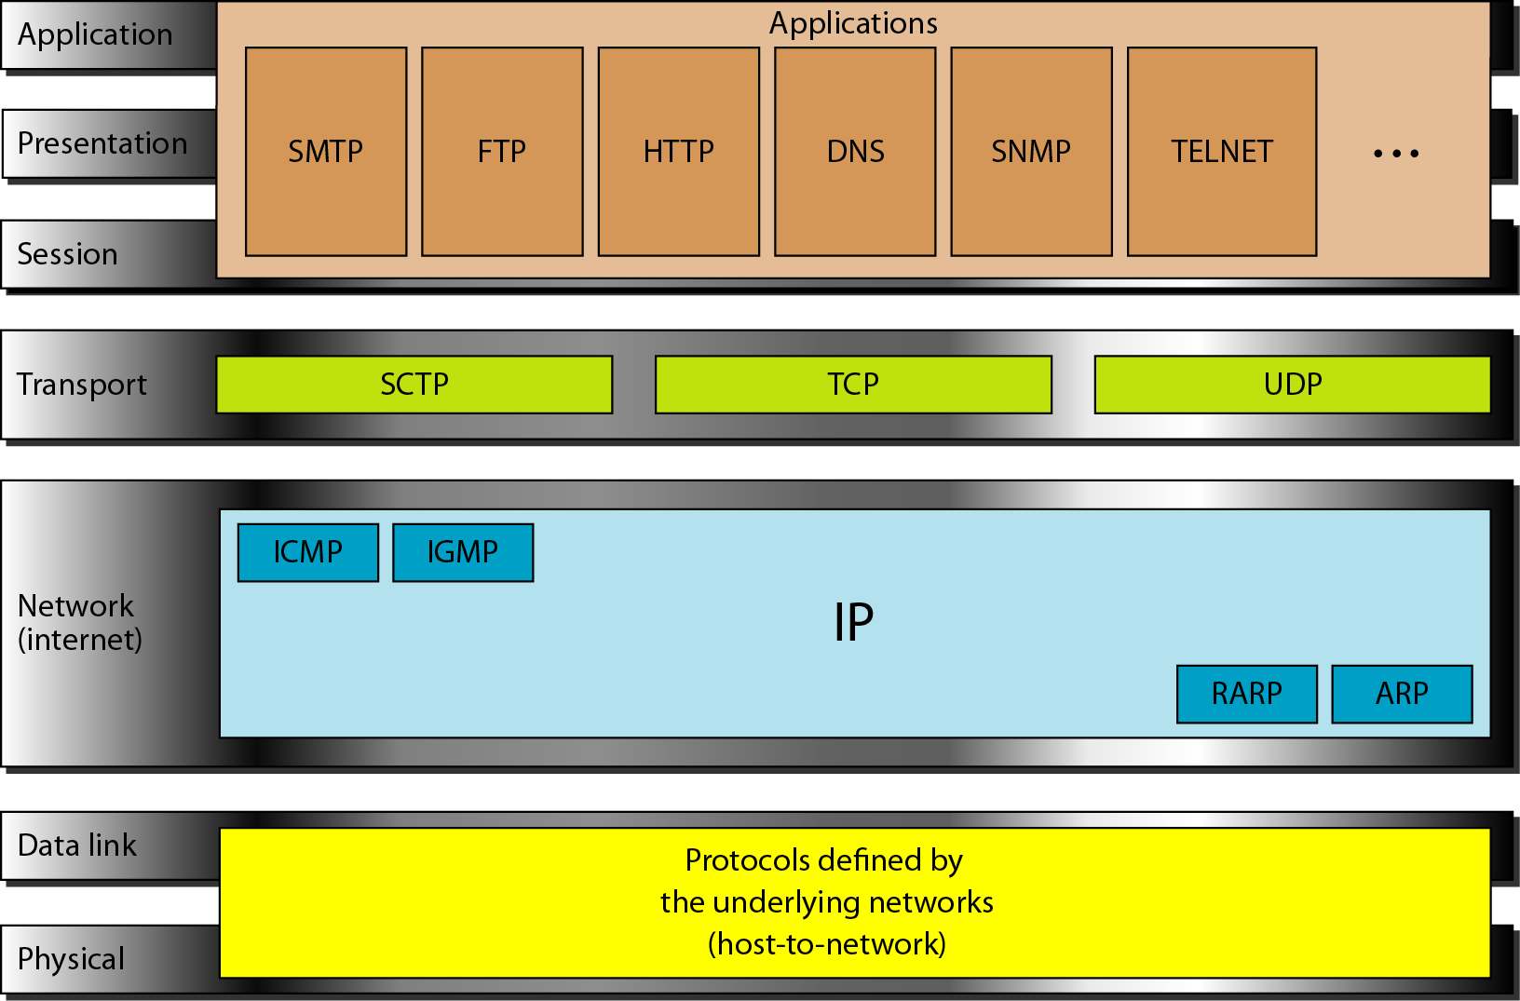
TCP/IP and OSI Model
2.4

Slide 5
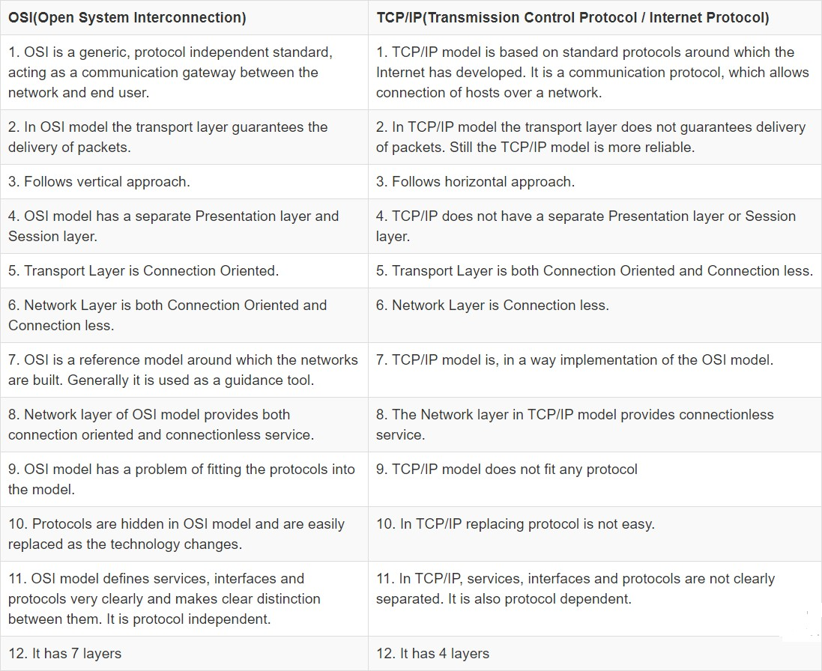
Difference between TCP/IP and OSI
Data Communication Lecture Series, NRC, MAY2020
2.5

Slide 6






















Addressing
Four levels of addresses are used in an internet employing the TCP/IP protocols: physical, logical, port, and specific.
Topics discussed in this section:
Physical Addresses Logical Addresses Port Addresses Specific Addresses

Slide 7
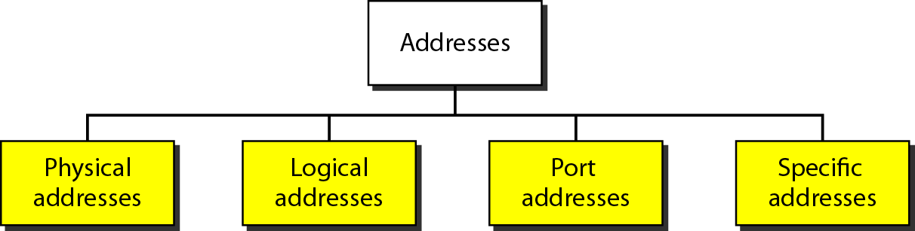
Addresses in TCP/IP

Slide 8
Physical Addresses
The physical address, also known as the link address, is the address of a node as defined by its LAN or WAN.
The size and format of these addresses vary depending on the network. For example, Ethernet uses a 6-byte (48-bit) physical address.
Physical addresses can be either unicast (one single recipient), multicast (a group of recipients), or broadcast (to be received by all systems in the network.
Example: Most local area networks use a 48-bit (6-byte) physical address written as 12 hexadecimal digits; every byte (2 hexadecimal digits) is separated by a colon, as shown below: A 6- byte (12 hexadecimal digits) physical address 07:01:02:01:2C:4B

Slide 9
Logical Addresses
Logical addresses are used by networking software to allow packets to be independent of the physical connection of the network, that is, to work with different network topologies and types of media.
A logical address in the Internet is currently a 32-bit/128-bit address that can uniquely define a host connected to the Internet. An internet address in IPv4 in decimal numbers 132.24.75.9
No two publicly addressed and visible hosts on the Internet can have the same IP address.
The physical addresses will change from hop to hop, but the logical addresses remain the same.
The logical addresses can be either unicast (one single recipient), multicast (a group of recipients), or broadcast (all systems in the network). There are limitations on broadcast addresses.

Slide 10
Port Addresses
There are many application running on the computer. Each application run with a port no.(logically) on the computer.
A port number is part of the addressing information used to
identify the senders and receivers of messages.
Port numbers are most commonly used with TCP/IP connections.
These port numbers allow different applications on the same computer to share network resources simultaneously.
The physical addresses change from hop to hop, but the logical and port addresses usually remain the same.
Example: a port address is a 16-bit address represented by one decimal number 753

Slide 11
Specific Addresses
Some applications have
user-friendly addresses that are
designed for that specific application.
Examples include the e-mail address (for example,
Resource
narayan@daffodilvarsity.edu.bd) and the Universal
Locator (URL) (for example, www.daffodilvarsity.edu.bd). The first defines the recipient of an e-mail; the second is used to find a document on the World Wide Web.

Slide 12
Exercises
Go through the exercises given at the end of the chapter. Note that, we are following the 4th Edition of Forouzan Book for this chapter.

Slide 13


